Slide 1
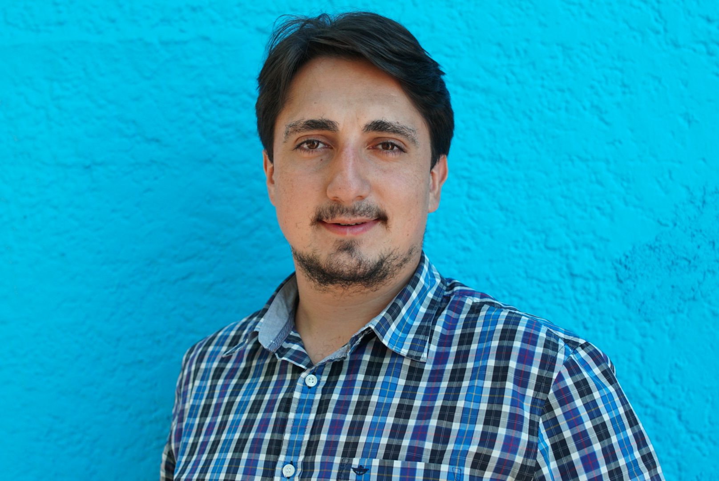
SMART BUILDINGS
ENERGY EFFICIENCY
EARLY STAGE
AI BASED HVAC CONTROL MODELS FOR COMMERCIAL BUILDINGS
Sensgreen develops intelligent HVAC control models, which aim to improve existing scenarios and bring a data-driven approach to traditional energy management in commercial buildings.
Commercial real estates are responsible for more than 25% of global energy consumption, where there is much room for improvement. We aim to provide a plug&play tool for existing building management systems, that offer a decent amount of savings effortlessly.
MENA-TR
Current operations
$150k
Grants & Investment
72 Hours
An average installation takes
HASAN BASRI TOSUN
Co-Founder & CEO
tosun@sensgreen.com
www.sensgreen.com
Want local partners in Asia
Raising seed round
Looking for advisors
Dim Sum with Entrepreneurs

