Slide 1
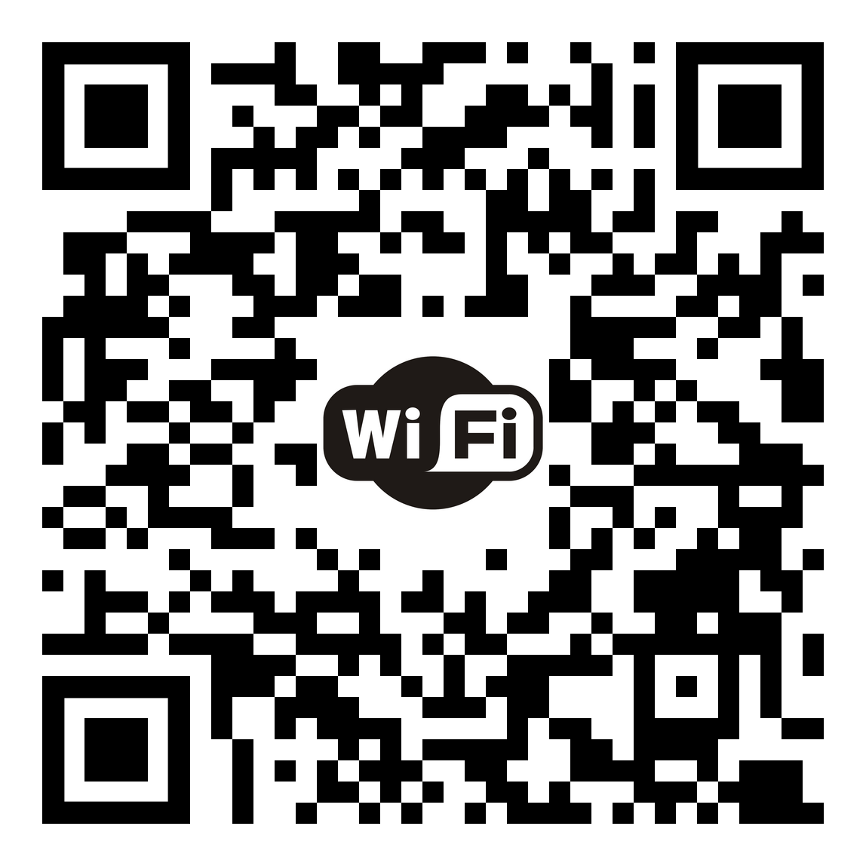
OPENING PLENARY
Secondary Text
Scan for more details
XX June 2025 • XX–XX a.m.
Venue

